Slide 1

Geometry
Unit 9, Lesson 8 Surface Area of Three-Dimensional Figures Volume 2, pg. 93

Slide 2


Benchmark
MA.912.GR.4.6
Solve mathematical and real-world problems involving the surface area of three-dimensional figures limited to cylinders, pyramids, prisms, cones, and spheres.
volume 2, pg. 93

Slide 3
Integrated Mathematical Thinking and Reasoning Standards
MA.K12.MTR.1.1 Actively participate in effortful learning both individually and collectively.
MA.K12.MTR.2.1 Demonstrate understanding by representing problems in multiple ways.
MA.K12.MTR.4.1 Engage in discussions that reflect on the mathematical thinking of self and others.
MA.K12.MTR.5.1 Use patterns and structure to help understand and connect mathematical concepts.
volume 2, pg. 93

Slide 4

Learning Targets
I can solve mathematical problems involving the surface area of cylinders, pyramids, prisms, cones, and spheres.
I can solve mathematical problems involving the lateral area of cylinders, pyramids, prisms, cones, and spheres.
volume 2, pg. 93

Slide 5

Warm-Up
volume 2, pg. 94

Slide 6
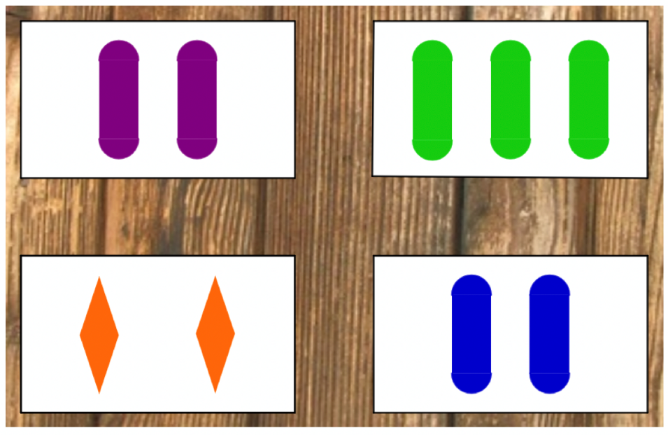
9.8.1 Warm-Up: Which One Doesn’t Belong?
Which one doesn’t belong? Explain your answer.
volume 2, pg. 94

Slide 7

Collaboration
volume 2, pg. 94

Slide 8


9.8.2 Collaboration: Using Nets to Find Surface Area
The lateral area of a three-dimensional figure is the sum of the area of the figure’s faces.
The surface area of a three-dimensional figure is the sum of the lateral area of the figure’s faces and the area of the figure’s bases.
volume 2, pg. 94

Slide 9
Work with your partner to determine a formula for the lateral area and the surface area of the figure you have been given. Complete the table.
Our figure was:
Dimension
Variable Used
volume 2, pg. 94

Slide 10

Activity
volume 2, pg. 95

Slide 11

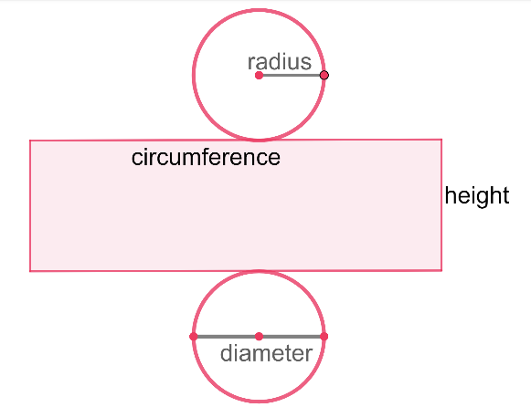
9.8.3 Activity: Gallery Walk
During the gallery walk, record the formulas. Make any useful notes on each figure’s net.
Figure | Net
Cylinder
Lateral Area =
Surface Area =
volume 2, pg. 95

Slide 12
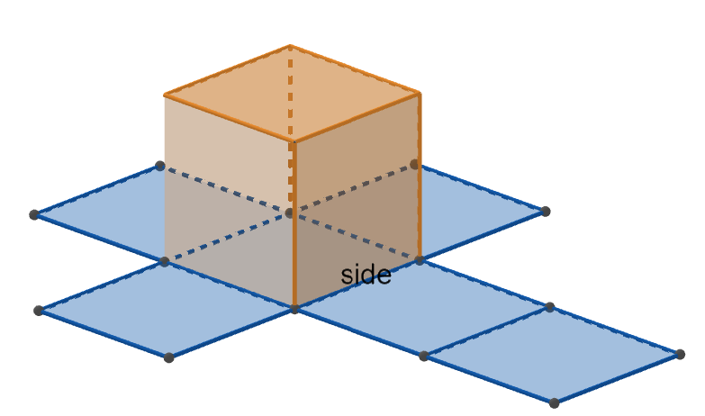
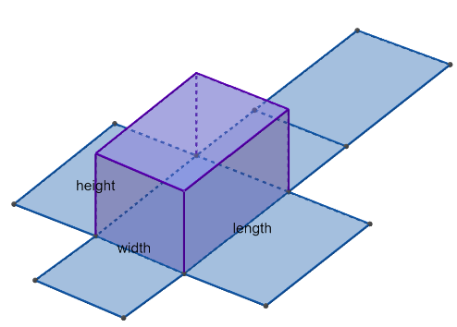
Figure | Net
Cube Lateral Area = Surface Area =
Rectangular Prism Lateral Area = Surface Area =
volume 2, pg. 95

Slide 13
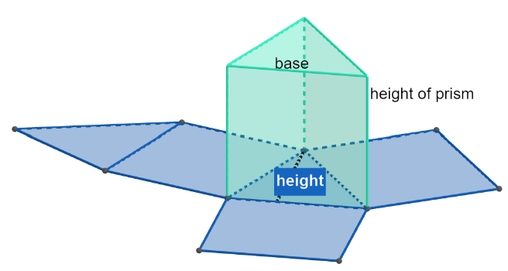
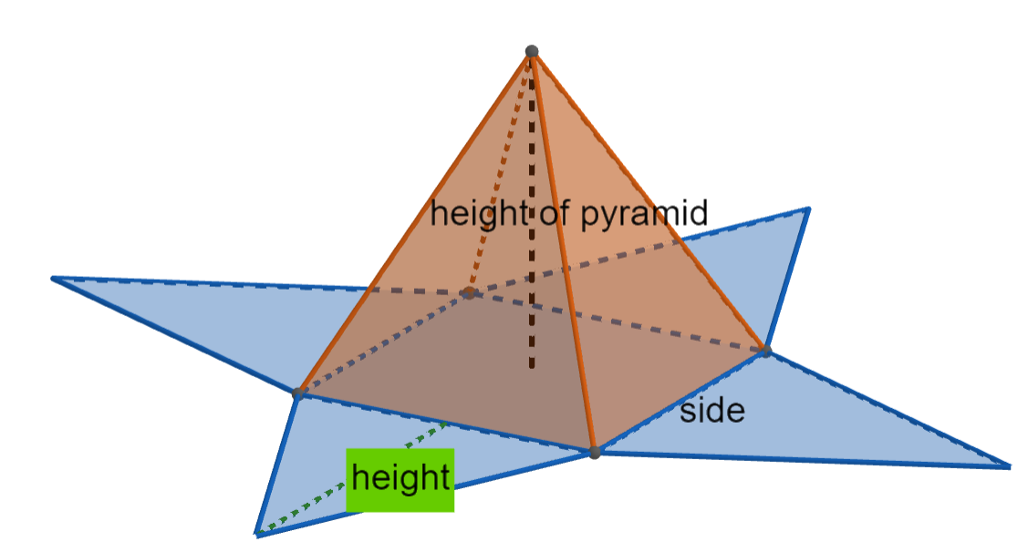
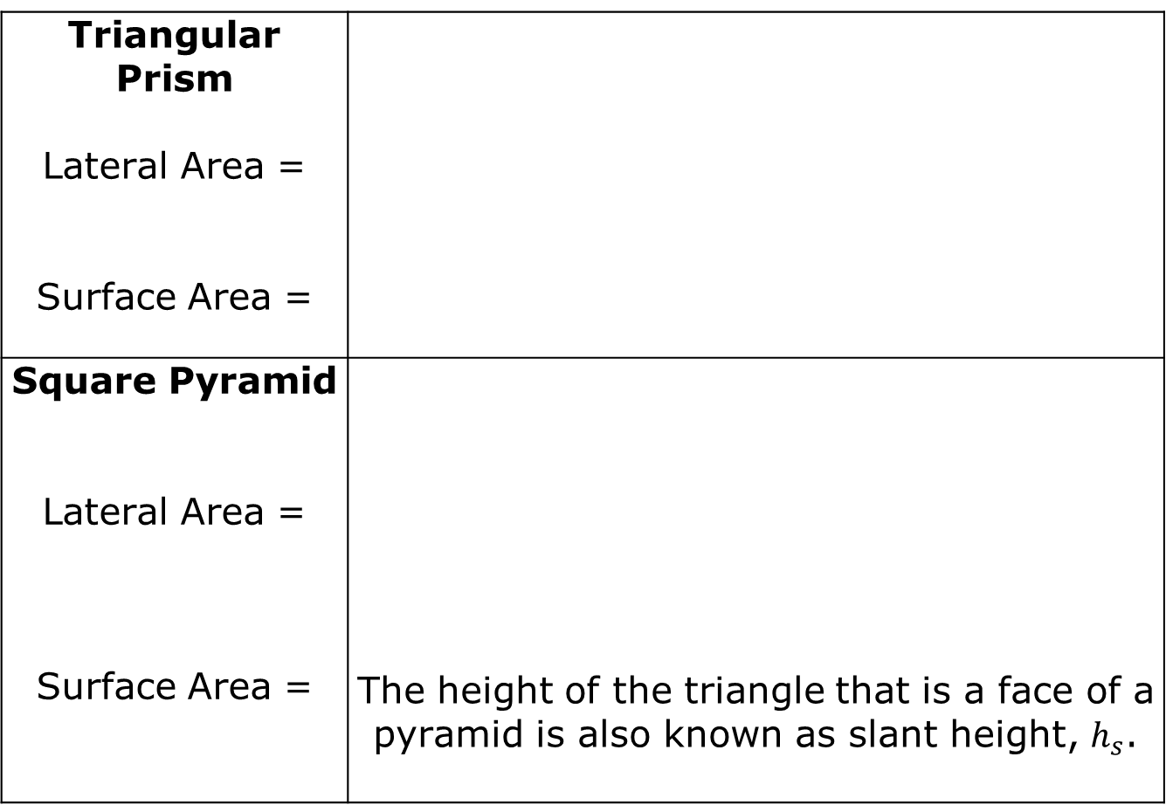
Triangular Prism Lateral Area = Surface Area =
Square Pyramid Lateral Area = Surface Area = | The height of the triangle that is a face of a pyramid is also known as slant height, $h_{s}$.
volume 2, pg. 95

Slide 14
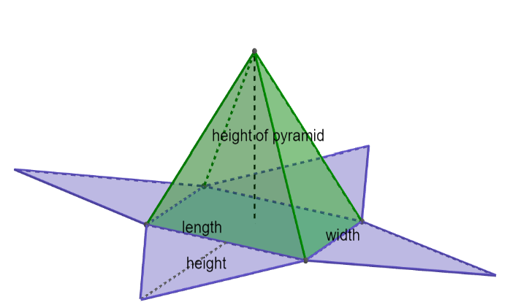
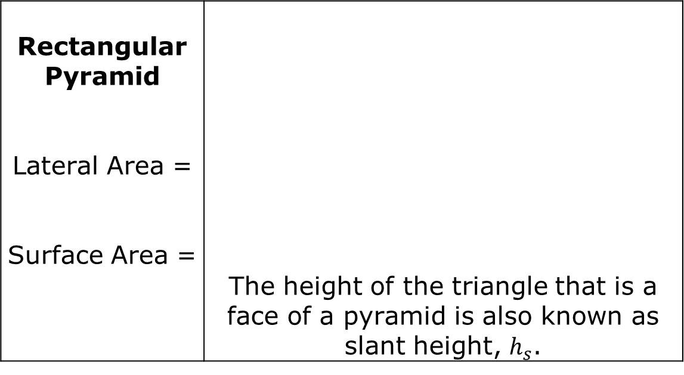
Rectangular Pyramid Lateral Area = Surface Area = | The height of the triangle that is a face of a pyramid is also known as slant height, $h_{s}$.
volume 2, pg. 95

Slide 15

Bring It Together
volume 2, pg. 96

Slide 16

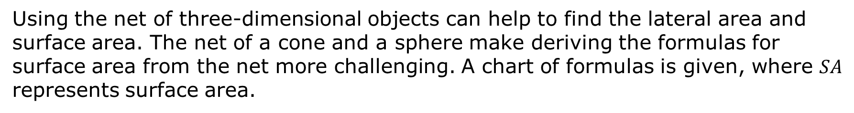
9.8.4 Bring It Together: Formulas
Using the net of three-dimensional objects can help to find the lateral area and surface area. The net of a cone and a sphere make deriving the formulas for surface area from the net more challenging. A chart of formulas is given, where $SA$ represents surface area.
volume 2, pg. 96

Slide 17
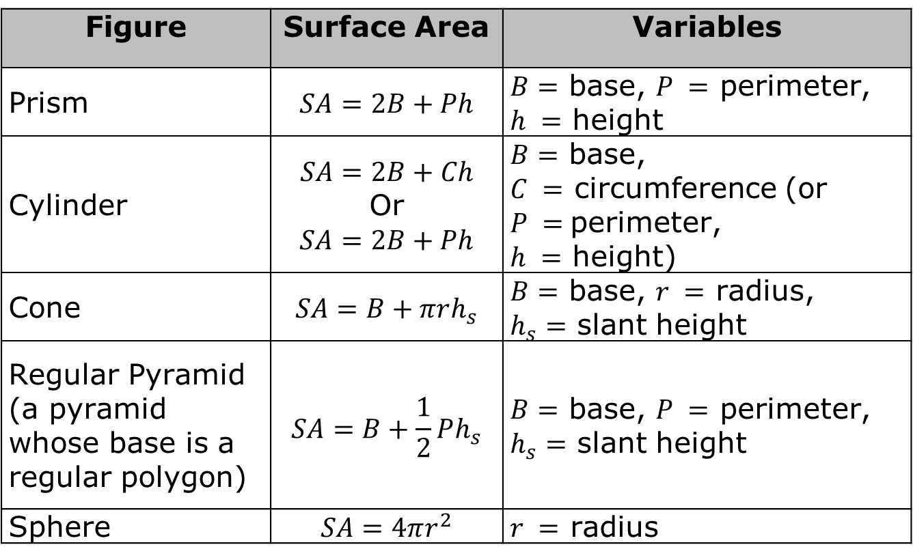
Figure | Surface Area | Variables
Prism | $$SA=2B+Ph$$ | $B=$ base, $P =$ perimeter, $h =$ height
Cylinder | $$SA=2B+Ch$$ Or $$SA=2B+Ph$$ | $B=$ base, $C =$ circumference (or $P =$perimeter, $h =$ height)
Cone | $$SA=B+πrh_{s}$$ | $B=$ base, $r =$ radius, $h_{s}=$ slant height
Regular Pyramid (a pyramid whose base is a regular polygon) | $$SA=B+\frac{1}{2}Ph_{s}$$ | $B=$ base, $P =$ perimeter, $h_{s}=$ slant height
Sphere | $$SA=4πr^{2}$$ | $r =$ radius
The formulas in the table may not match the formulas recorded during the gallery walk. Which figures have formulas that are different?
volume 2, pg. 96

Slide 18
There are many ways to write and to understand formulas. Discuss with your partner which formulas make more sense to you. Discuss how the formulas in the formula chart can be used to help you remember how to find surface area. Summarize your discussion.
The chart does not have a formula for lateral area. For each of the figures, except for spheres, circle the part of the surface area formula that gives the lateral area.
volume 2, pg. 96

Slide 19

Guided Instruction
volume 2, pg. 97

Slide 20
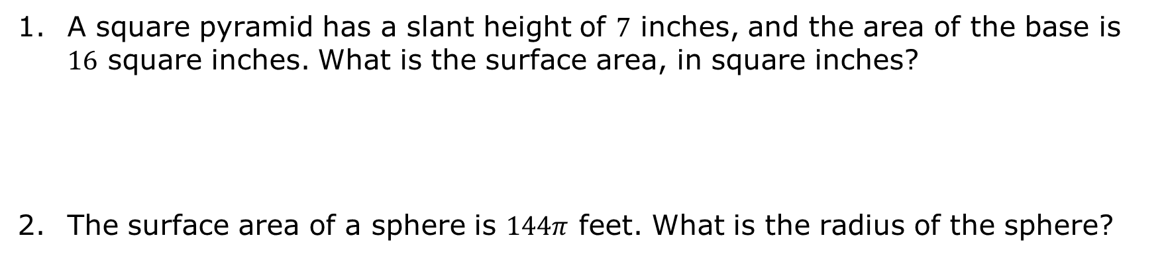
9.8.5 Guided Instruction: Lateral Area and Surface Area
A square pyramid has a slant height of $7$ inches, and the area of the base is $16$ square inches. What is the surface area, in square inches?
The surface area of a sphere is $144π$ feet. What is the radius of the sphere?
volume 2, pg. 97

Slide 21
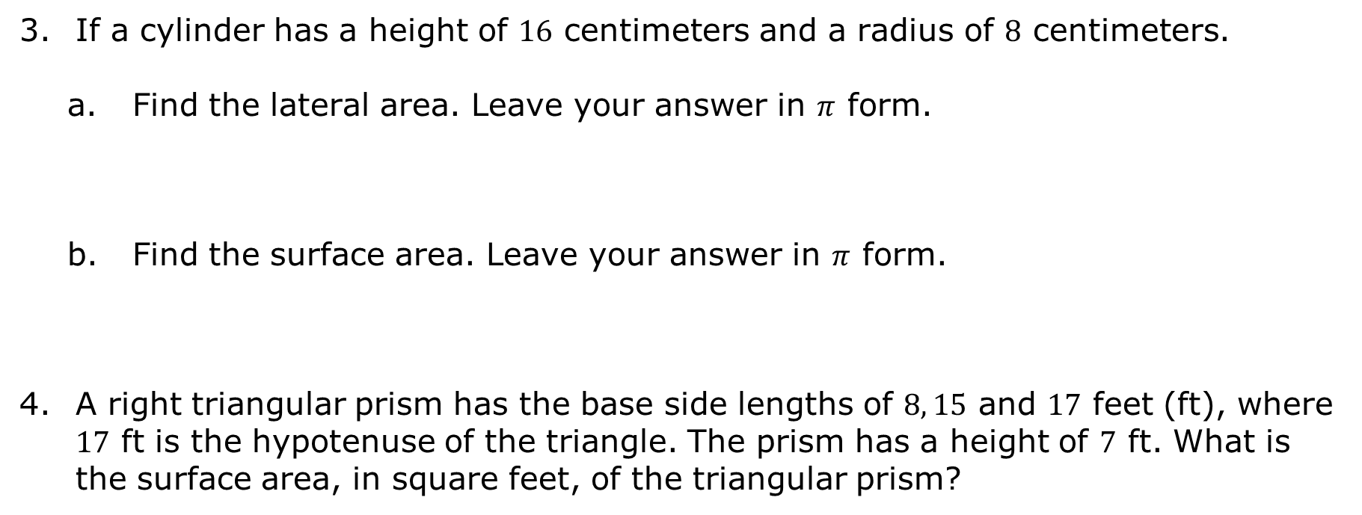
If a cylinder has a height of $16$ centimeters and a radius of $8$ centimeters.
Find the lateral area. Leave your answer in $π$ form.
Find the surface area. Leave your answer in $π$ form.
A right triangular prism has the base side lengths of $8, 15$ and $17$ feet (ft), where $17$ ft is the hypotenuse of the triangle. The prism has a height of $7$ ft. What is the surface area, in square feet, of the triangular prism?
volume 2, pg. 97

Slide 22

Guided Practice
volume 2, pg. 98

Slide 23

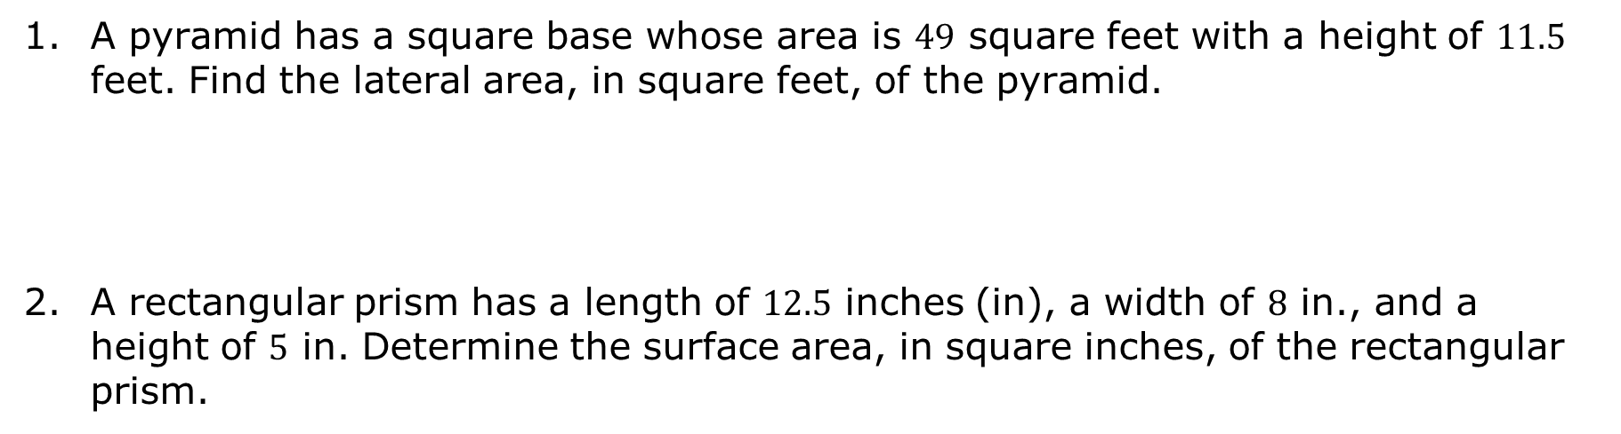
9.8.6 Guided Practice: Lateral Area and Surface Area
A pyramid has a square base whose area is $49$ square feet with a height of $11.5$ feet. Find the lateral area, in square feet, of the pyramid.
A rectangular prism has a length of $12.5$ inches (in), a width of $8$ in., and a height of $5$ in. Determine the surface area, in square inches, of the rectangular prism.
volume 2, pg. 98

Slide 24
The radius of a sphere is $18.7$ feet. Find, in square feet, the surface area of the sphere. Round your answer to thousandths place.
volume 2, pg. 98

Slide 25

Your Turn
volume 2, pg. 99

Slide 26
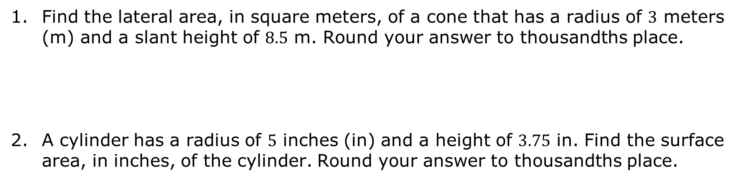
9.8.7 Your Turn!
Find the lateral area, in square meters, of a cone that has a radius of $3$ meters (m) and a slant height of $8.5$ m. Round your answer to thousandths place.
A cylinder has a radius of $5$ inches (in) and a height of $3.75$ in. Find the surface area, in inches, of the cylinder. Round your answer to thousandths place.
volume 2, pg. 99

Slide 27

Wrap-Up
volume 2, pg. 99

Slide 28
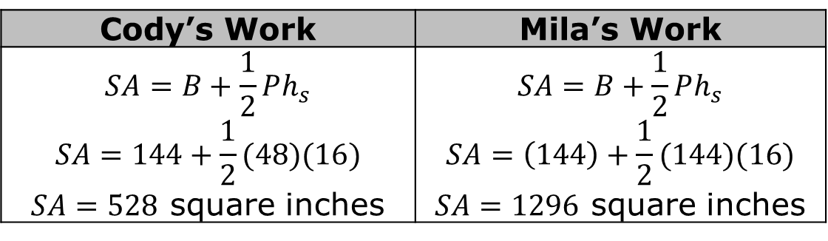

9.8.8 Wrap-Up: Error Analysis
Cody and Mila are finding the surface area of a pyramid whose base area is $144$ square inches and slant height is $16$ inches. Their work is shown in the table.
Whose work is correct?
Write a note to the student whose work is incorrect describing the mistake the student made.
Cody’s Work | Mila’s Work
$$SA=B+\frac{1}{2}Ph_{s}$$ $$SA=144+\frac{1}{2}(48)(16)$$ $SA=528$ square inches | $$SA=B+\frac{1}{2}Ph_{s}$$ $$SA=\left(144\right)+\frac{1}{2}(144)(16)$$ $SA=1296$ square inches
volume 2, pg. 99

